Slide 1
Explorers DofE Expedition Planning 2022

Slide 2
Welcome
Things about the building:
Toilets
Water/Refreshments
Fire escapes
Areas we can use
Room Layouts
Entering and Exiting the building
Any questions so far?

Slide 3
Things we need to do today
Plan your expedition Routes
Assessed for Bronze
Practice and Assessed for Silver
Create your meal plan
Assessed for Bronze
Practice and assessed provisional for Silver
Kit List
Group kit
Sleeping arrangements
Items needed for aim
What happens if we don’t finish today?

Slide 4
Kit List
No requirement for formal kit list.
DofE website has suggested kit list.
Each person needs to know what they are responsible for bringing.
We need to know what we need to give you.
Unless you ask otherwise we will give you:
2 x Trangia's
Fuel for Trangia's
Maps
Compasses
2 Tents
If you need anything else you need to tell us.

Slide 5
Meal Plan
You need to specify what food you are going to take. Considerations:
How many calories are is your food?
How are you going to cook it (one cooked meal on each day other than the last)?
Is the food suitable for being carried and not being refrigerated?
Who is going to buy which things?
Allergies, intolerances and other dietary requirements?
How are going to eat it (no point bringing soup but no mugs or bowls)?
Emergency Rations

Slide 6
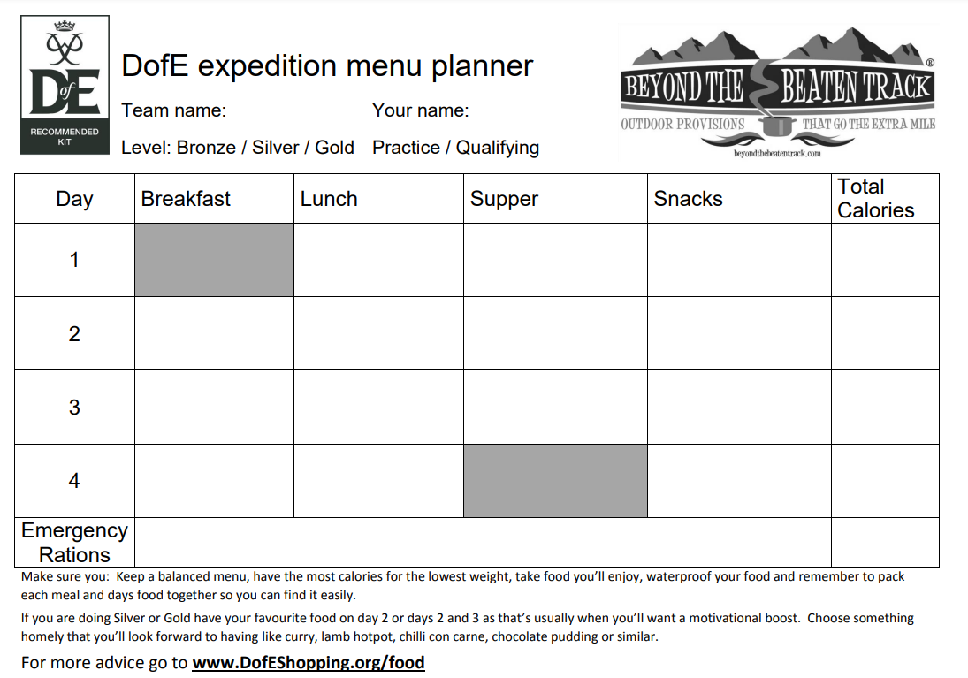
Meal Plan Template

Slide 7
Route Planning
A route is planned when:
1. We have a complete route for each day of your expedition as a separate route on DofE mapping
2. We have a fully completed route card for each day of the route
3. We have agreed that your aim is suitable.
4. We have checked your route and confirmed that it is safe and suitable.
5. Where appropriate your route is also marked on your map
Routes must be finished no later than 2 weeks before your expedition

Slide 8
Expedition areas
Bronze:
One, two day assessed expedition in the New Forest
Minimum of 6 hours between starting and ending, of which at least 3 must be travelling.
Silver:
One three day practice expedition in the South Downs national park.
One three day assessed expedition in Purbeck.
Minimum of 7 hours between starting and ending, of which at least 3.5 must be travelling.

Slide 9
Route Planning
Identify a start point, end point and where you are going to camp.
Bronze you don’t have to start, camp and finish in the same place as the other group (but it would be helpful).
Start and End points should have carparking and you may wish to consider toilets
Camp sites must accept DofE groups (and if they are expensive you might need to part fund).
Assume you will walk at about 3kph.
Consider your aim when planning your routes

Slide 10
E-DofE Mapping
https://www.youtube.com/watch?v=eeqYYf05VEE&ab_channel=PaulTurner

Slide 11
Next steps
Go and choose a room for your group. (Silver consider splitting in half and doing one expedition each).
Bronze if you want to split in half and do a day each we can make that work.
Make use of the time, it doesn’t take 6 people to plot a route, get working on the kit list and meal planner.
The time is your own, stop for Lunch/Breaks as and when you want.
Anything you don’t finish today you will have to finish in your own time.
We will be floating between rooms, grab us if you need help or have questions.
Any Questions?

